Slide 1
OUR PETS
AND
OTHER ANIMALS
НАШИ ПИТОМЦЫ
И ДРУГИЕ ЖИВОТНЫЕ

Slide 2
What have you got?
Is it big or small?
What colour is it?
Can it run?
Can it jump?
Can it have food?
Can it fly?
Can it dance?

Slide 3
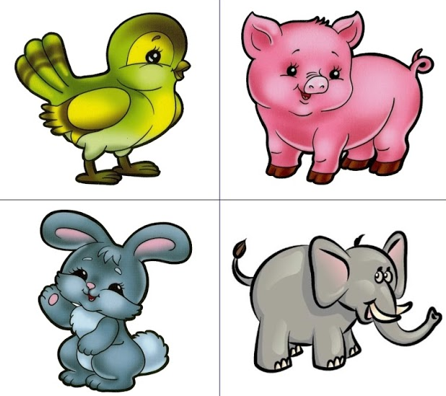

Slide 4
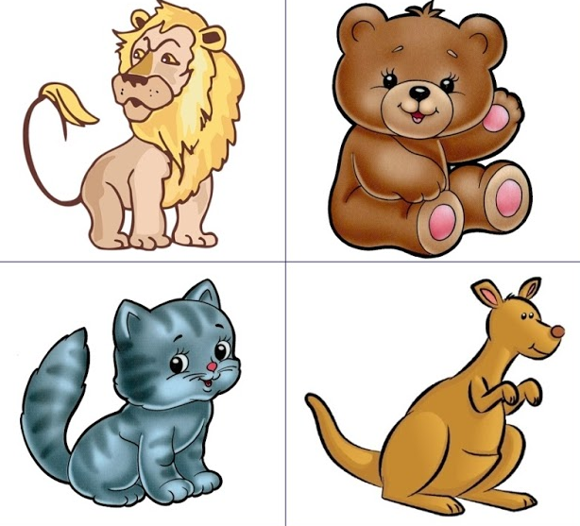

Slide 5
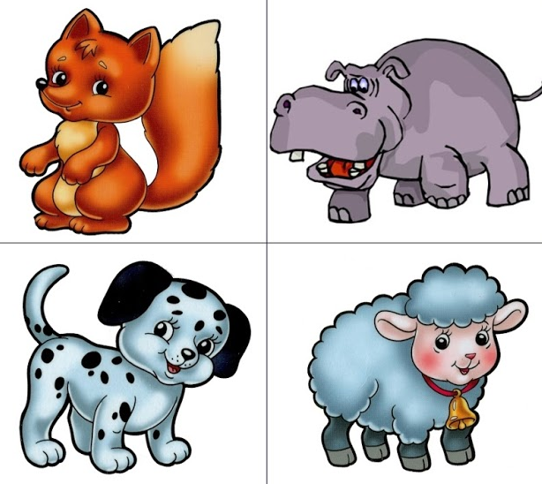

Slide 6
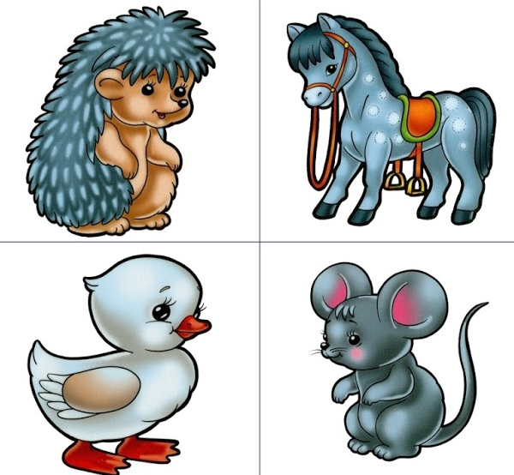

Slide 7
9. giraffe
10. zebra
11. parrot
12. snake
13. peacock
14. monkey
15. tortoise
16. shark
1. lion
2. bear
3. elephant
4. rhino
5. hippo
6. panda
7. tiger
8. wolf

Slide 9
PETS
FARM ANIMALS
WILD ANIMALS

Slide 10
What can we do with animals?
LOOK AFTER
GIVE FOOD
WALK
PLAY
TEACH
SPEAK ENGLISH

Slide 11
What can we do with animals?
LOOK AFTER
GIVE FOOD
WALK
PLAY
TEACH
SPEAK ENGLISH
ЗАБОТИТЬСЯ
КОРМИТЬ
ГУЛЯТЬ
ИГРАТЬ
УЧИТЬ
ГОВОРИТЬ ПО-АНГЛИЙСКИ

Slide 12
THANK YOU
FOR THE LESSON

